Slide 1
Wearable Technology
Michael Smith

Slide 2
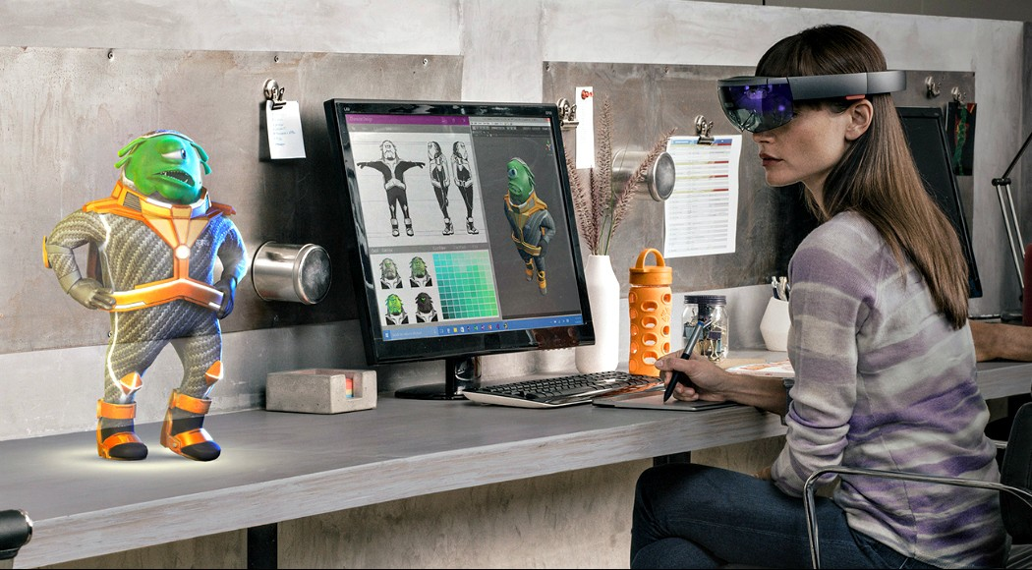
Introduction
As the development of wearable technology progresses, leading into fields such as Augmented Reality, concerns are being raised and preemptive bans are in place to prevent this technology in social atmospheres. Not to mention the business aspects, and the leaking of person information.
Notes:
Wearable technology can bring "Facebook Creeping" out into the real world and be used in real time. Or imagine your boss knowing that you actually called out sick to go to a theme park. Or your doctor messaging you because he noticed that your heart rate is becoming irregular.

Slide 3

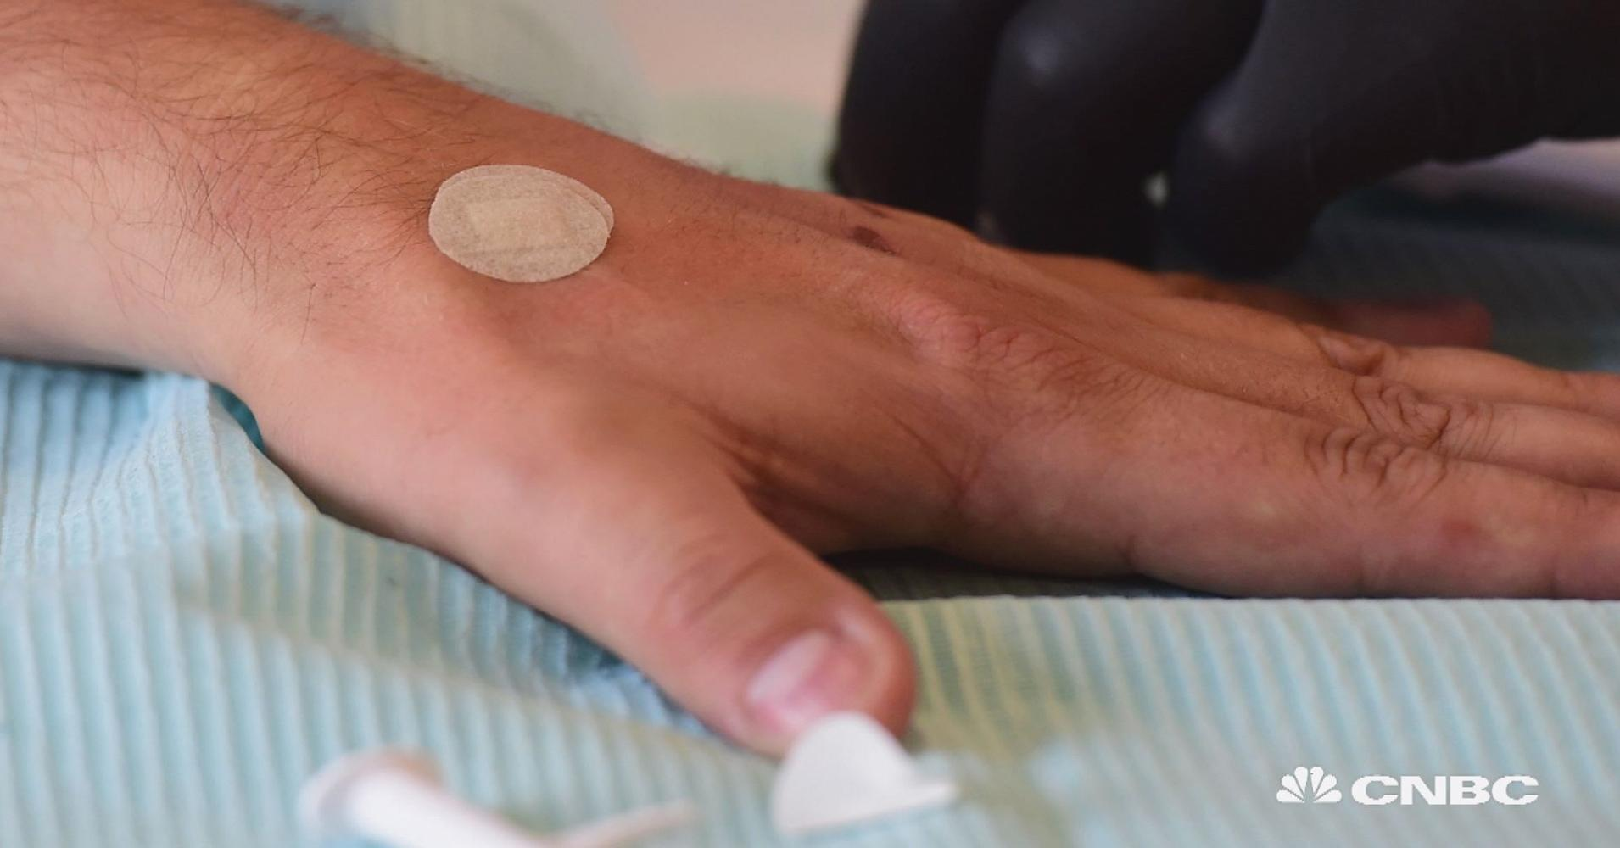
Case Details
There are three scenarios that are a concern when it comes to the benefits/negatives of wearable technology:
Social Engineering
Business
Health
Notes:
Social Engineering – Imagine walking into a building wear not only are you being recorded by the security cameras, but also by people you are talking to or just standing near. Or being researched in social media by the person you are holding a conversation with. These things are possible and will become more prominent.
Business – No longer having to carry security cards or remembering any passwords to login to terminals. Just a wave of your hand and doors open and computers come on. Are you willing to take this benefit with the possibility that it could also be tracking your heart rate to determine emotional status or stress levels. Or even your location.
Health - Your doctor texts you, questioning why your heart rate has become irregular. Just checking on you to make sure you are okay. However at the same time you insurance providers got that same alert and your policies and rates are being changed due to risk of heart issues because of the irregularness.

Slide 4
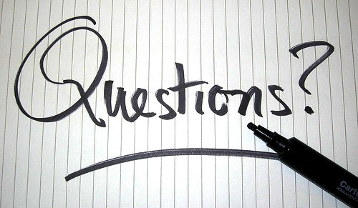
Case Question
Should we put a limit to what wearable technology should be able to do?
Is it okay to Google search somebody you are talking to in real time?
Is it okay for our bosses to monitor us during work hours?
Is it okay for your health information to be transferred real time to your insurance providers?

Slide 5
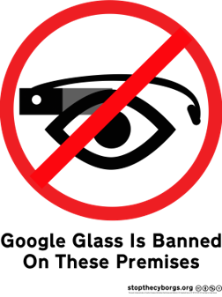
Case Standard
Currently there is no restrictions on what wearable technology can do; however, there have been bans on the technology in certain situations, and places. And boundaries being pushed.
In 2014, Glass has been banned from 13 bars and restaurants in the San Francisco area.
On August 1st, a Wisconsin company became the first business to implant microchips in its employees.
Wearables are struggling to make their mark in the health care world, due to a number of barriers.
Notes:
Glass was banned from these bars to prevent customers from being uncomfortable with the possibility that they are being recorded with Glass.
This software company is offering microchips to all of its employees; however, it is not required for them to have one. These microchips will allow employees to pay for food and drinks, open security doors and login to terminals without any cards or passwords.
Wearable technology would have to meet the strict regulations of Health Insurance Portability and the Accountability Act. As well they struggle with infrastructure issues with networks, and integration with current software and electronic health records.

Slide 6

Recommendation
The possibilities of wearable technology is an impressive field. However restrictions should start being applied to it. Wearable technology can cause an invasion of privacy; both in society as well as for the employees forced to wear implants. And the regulation of healthcare wearables needs to achieve perfect security to prevent personal information from leaking.

Slide 7
Case Solution
Respect people’s right to privacy.
Set limitations for what data can be collected.
Establish boundaries on what can be done with the data, and where it can end up.

Slide 8
References
https://thenextweb.com/insider/2013/03/27/how-the-new-wave-of-wearable-technology-could-transform-society/
http://www.foxbusiness.com/features/2017/07/24/wisconsin-company-to-implant-microchips-in-its-employees-in-august.html
http://www.businessinsider.com/google-glass-ban-san-francisco-2014-3

